Slide 1



Development of the Failure Criteria for Composites
Associate Professorship of Computational Mechanics and Professorship of Wood Technology
Department of Civil, Geo and Environmental Engineering
Technical University of Munich
Software Lab Project 2019 (Group #11)
1st Review Presentation
Group members:
Panagiotis Gavallas, Yasuyuki Shimizu, Ammar Khallouf
Project Supervisors:
Ani Khaloian
Michael Richter
Prof. Fabian Duddeck (Computational Mechanics Group)
Munich, 21. May 2019

Slide 2
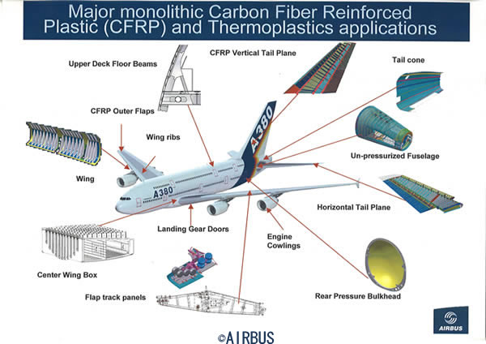
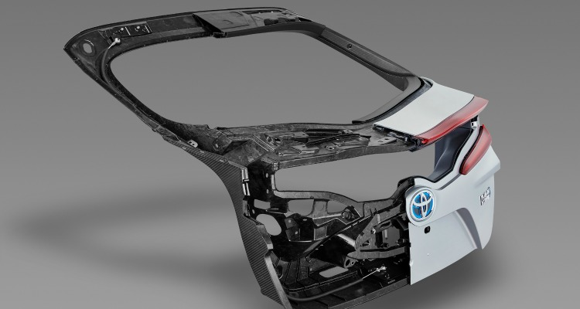
Overview and Motivation
Associate Professorship of Computational Mechanics and Professorship of Wood Technology
Department of Civil, Geo and Environmental Engineering
Technical University of Munich
Importance of composite materials is increasing
Superior properties (lightweight, specific stiffness).
High-performance engineering applications (Aerospace, Automotive, … industries).
The main composite part of AIRBUS airplane
©AIRBUS
Toyota Prius CFRP closure panel
©Toyota

Slide 3
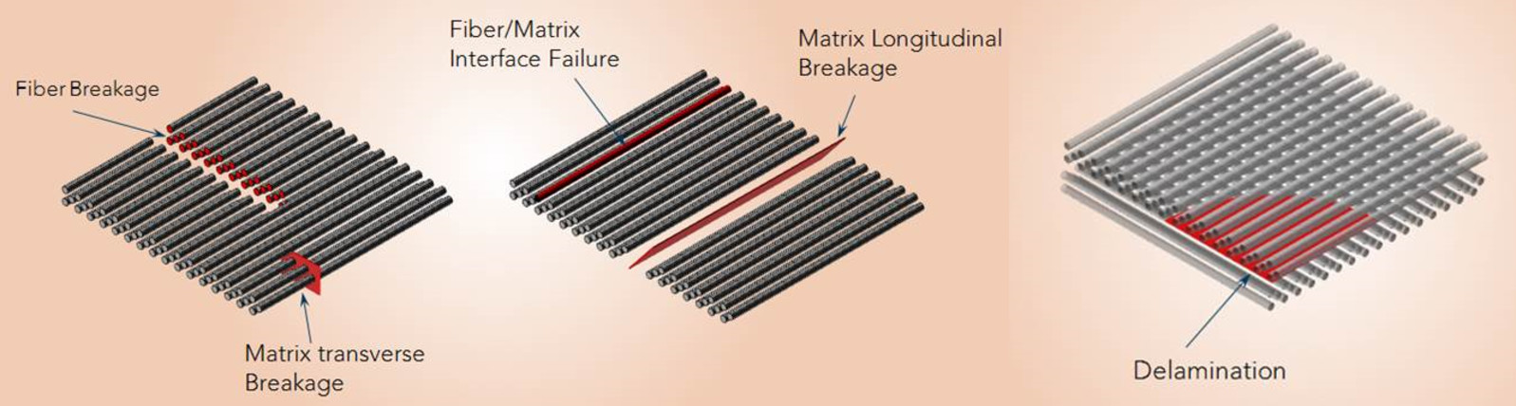
Overview and Motivation
Associate Professorship of Computational Mechanics and Professorship of Wood Technology
Department of Civil, Geo and Environmental Engineering
Technical University of Munich
Composite materials have complex behavior
Heterogeneous.
High anisotropy.
Multiple failure modes occur on different scales and under different loading conditions.
Intra and inter laminar failures of composites (Maya HTT,2015)
Predicting the accurate failure mode under complex stress state is a challenge.
Experiments and load tests are costly.
→FEA are favored to reduce experimental effort (cumbersome task).

Slide 4
Overview and Motivation
Associate Professorship of Computational Mechanics and Professorship of Wood Technology
Department of Civil, Geo and Environmental Engineering
Technical University of Munich
Limitations of current material models in commercial FE-codes
Very Basic formulation and limited directional capability.
Not compatible with all types of elements (e.g. solid elements).
Only few failure/damage models are available in the standard library.
→User-defined material models needed for more complex scenarios, especially in 3D
Project Workflow:
Selection of material model from the papers
Writing a code which express the material model (Fortran)
Applying them to commercial FE-codes (Abaqus)
Comparison of the results to experimental cases
(Literature review)
(Modelling and coding)
(Implementation)
(Validation)

Slide 5
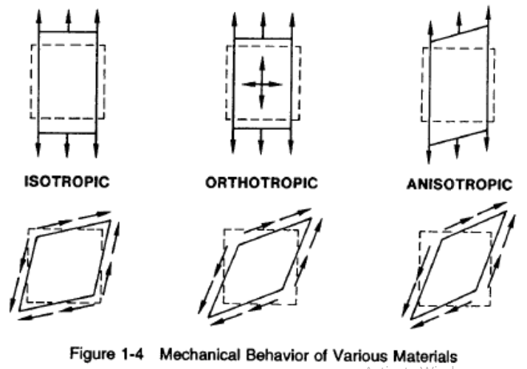
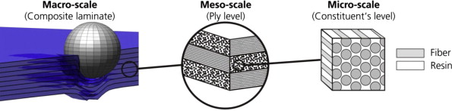
Composites Failure Criteria
Associate Professorship of Computational Mechanics and Professorship of Wood Technology
Department of Civil, Geo and Environmental Engineering
Technical University of Munich
Orthotropic material
Normal stress in a non principal material direction causes shear strain.
Different Young’s moduli along principal directions.
3 perpendicular planes of symmetry.
9 independent material constants.
Transversely isotropic material
Orthotropic with one plane of isotropy.
5 independent material constants.
Modelling scales
Can be studied on three different length scales.
Focus on macro-scale level in this project.
(R.M. Jones, 1999)
Multiscale material modelling
(TU Dresden,2017)

Slide 6
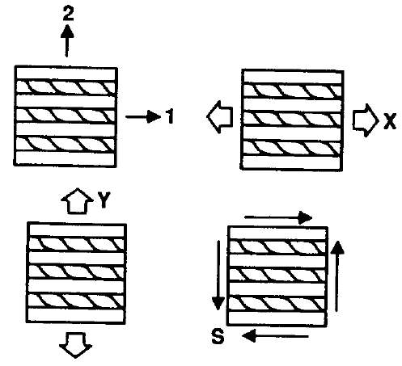
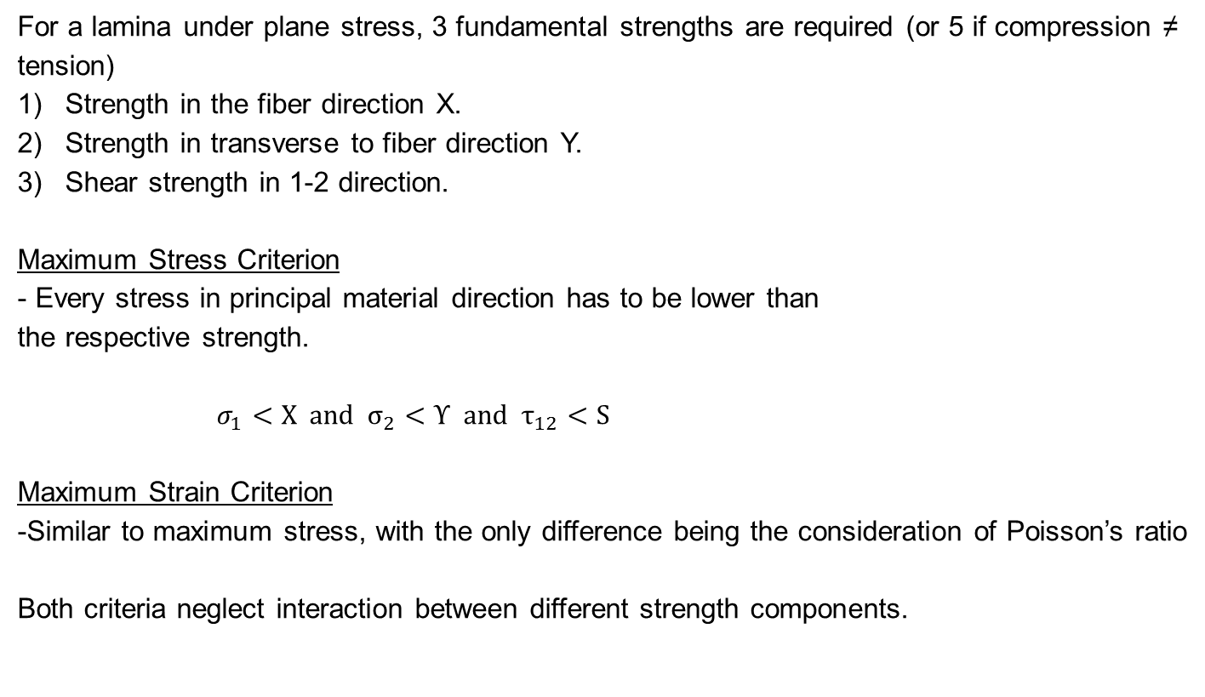
Composites Failure Criteria
Associate Professorship of Computational Mechanics and Professorship of Wood Technology
Department of Civil, Geo and Environmental Engineering
Technical University of Munich
For a lamina under plane stress, 3 fundamental strengths are required (or 5 if compression ≠ tension)
Strength in the fiber direction X.
Strength in transverse to fiber direction Y.
Shear strength in 1-2 direction.
Maximum Stress Criterion
- Every stress in principal material direction has to be lower than
the respective strength.
$σ_{1}<Χ and σ_{2}<Υ and τ_{12}<S$
Maximum Strain Criterion
-Similar to maximum stress, with the only difference being the consideration of Poisson’s ratio
Both criteria neglect interaction between different strength components.
Principal directions and resp. strength
(R.M. Jones,1999)

Slide 7
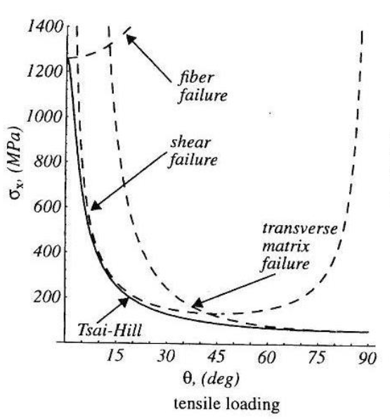
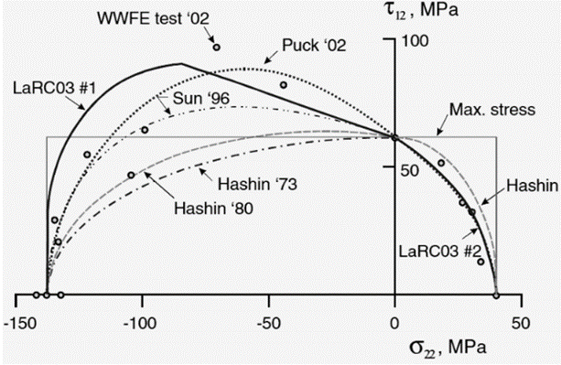

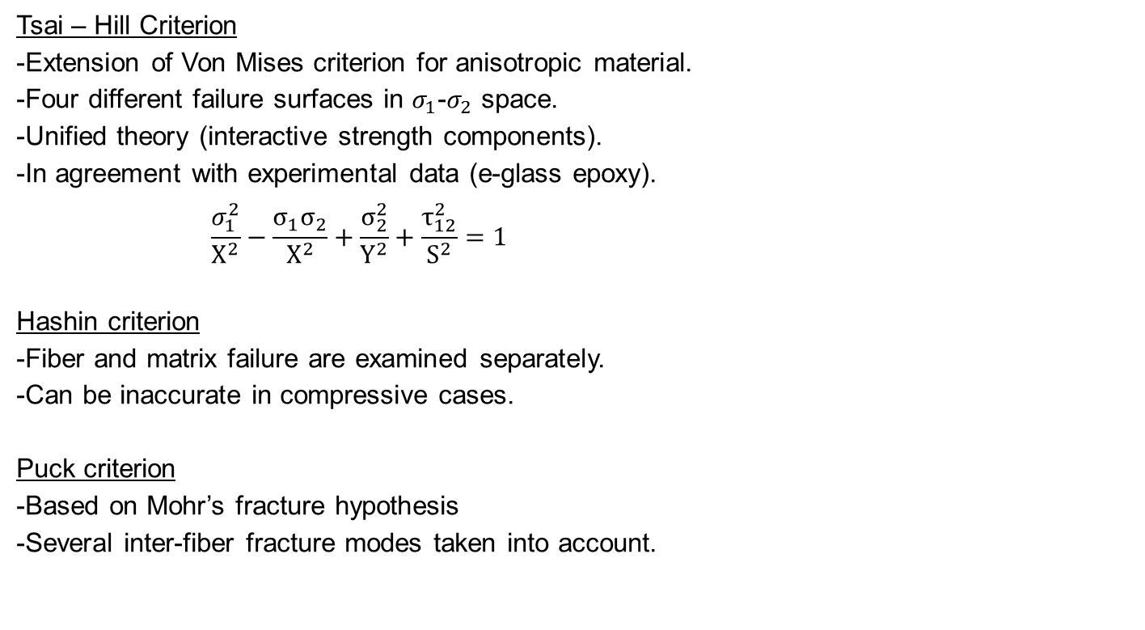
Composites Failure Criteria
Associate Professorship of Computational Mechanics and Professorship of Wood Technology
Department of Civil, Geo and Environmental Engineering
Technical University of Munich
Tsai – Hill Criterion
-Extension of Von Mises criterion for anisotropic material.
-Four different failure surfaces in $σ_{1}$-$σ_{2}$ space.
-Unified theory (interactive strength components).
-In agreement with experimental data (e-glass epoxy).
$$\frac{σ_{1}^{2}}{Χ^{2}}−\frac{σ_{1}σ_{2}}{Χ^{2}}+\frac{σ_{2}^{2}}{Y^{2}}+\frac{τ_{12}^{2}}{S^{2}}=1$$
Hashin criterion
-Fiber and matrix failure are examined separately.
-Can be inaccurate in compressive cases.
Puck criterion
-Based on Mohr’s fracture hypothesis
-Several inter-fiber fracture modes taken into account.

Slide 8


Development of User Material
Associate Professorship of Computational Mechanics and Professorship of Wood Technology
Department of Civil, Geo and Environmental Engineering
Technical University of Munich
ABAQUS User-Subroutines used as the development interface for the custom material.
Written as Fortran code and passed to the FE model when executing the analysis.
UMAT is the user subroutine for the definition of constitutive models in ABAQUS/Standard (VUMAT in ABAQUS/Explicit).
Constitutive models of arbitrary complexity can be defined.
Failure and damage criteria can be incorporated accordingly.
The following software is required to run subroutines in ABAQUS:
-Visual Studio (Code development platform)
-Intel Fortran Studio XE (Compiler)

Slide 9
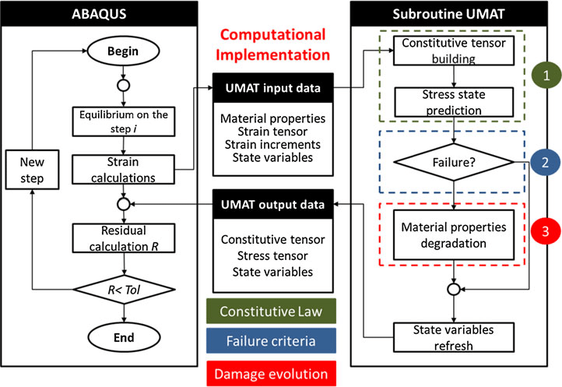
Development of User Material
Associate Professorship of Computational Mechanics and Professorship of Wood Technology
Department of Civil, Geo and Environmental Engineering
Technical University of Munich
UMAT Integration in ABAQUS
Ribeiro, Vandepitte and Tita (2013)

Slide 10
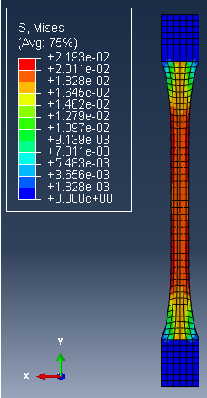
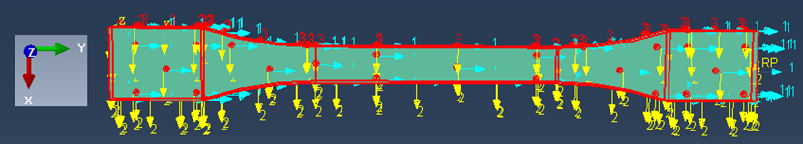
Current Progress and Future Timeline
Associate Professorship of Computational Mechanics and Professorship of Wood Technology
Department of Civil, Geo and Environmental Engineering
Technical University of Munich
The following tasks are accomplished:
Literature Study:
-Mechanics of composite materials.
-Review of composite failure theories.
-Modelling procedures in FEA.
Modelling in ABAQUS:
-Simulation of simple tensile test.
-Effect of material direction on stress-strain response.
-Mesh convergence study with 2D/3D elements.
Setting Up Work Environment:
-Linking ABAQUS to Intel Fortran compiler.
-Testing using simple UMAT for isotropic material.
Modelling Exercise in ABAQUS

Slide 11
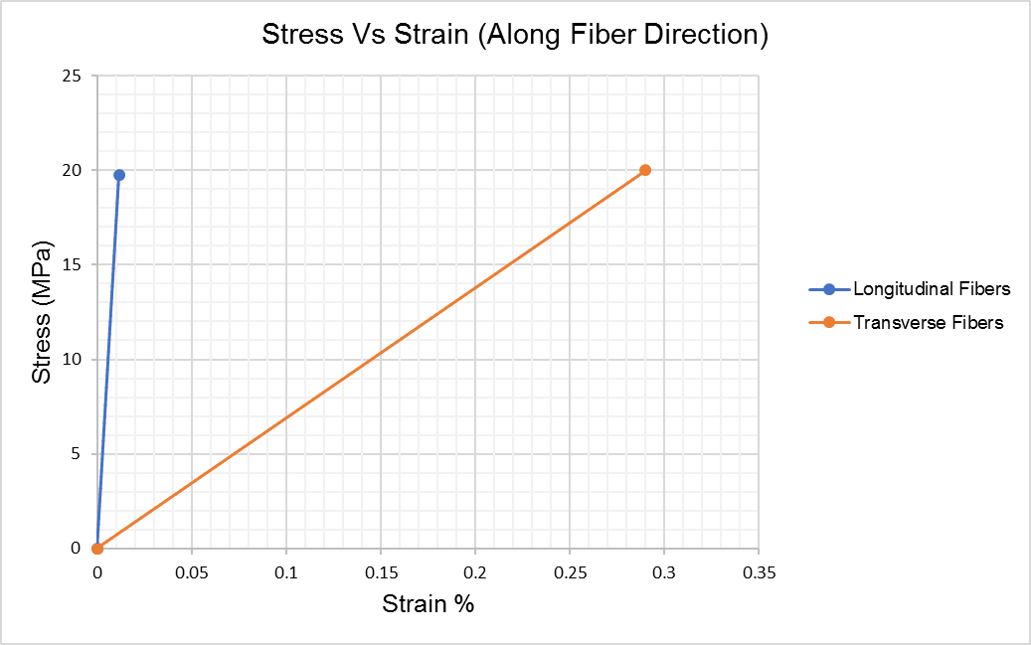
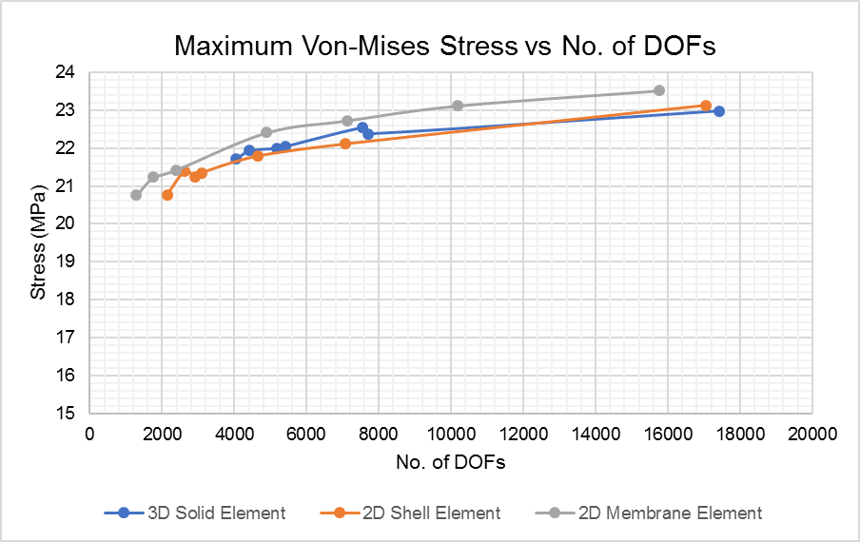
Current Progress and Future Timeline
Associate Professorship of Computational Mechanics and Professorship of Wood Technology
Department of Civil, Geo and Environmental Engineering
Technical University of Munich
Modelling results in ABAQUS:

Slide 12
Current Progress and Future Timeline
Associate Professorship of Computational Mechanics and Professorship of Wood Technology
Department of Civil, Geo and Environmental Engineering
Technical University of Munich
Proposed Future time plan as follows :

Slide 13
Current Progress and Future Timeline
Associate Professorship of Computational Mechanics and Professorship of Wood Technology
Department of Civil, Geo and Environmental Engineering
Technical University of Munich
Proposed Future time plan as follows :

Slide 14
References
Associate Professorship of Computational Mechanics and Professorship of Wood Technology
Department of Civil, Geo and Environmental Engineering
Technical University of Munich
Kaw, A. K. (2005). Mechanics of composite materials. CRC press.
Carrera, E. (2018). Implementation of classical and advanced failure criteria for composite layered structures in FEMAP and assessment of results (Doctoral dissertation, Politecnico di Torino).
ATAR, M. B. (2016). EXPERIMENTAL AND NUMERICAL FAILURE ANALYSIS OF ADVANCED COMPOSITE STRUCTURES WITH HOLES (Doctoral dissertation, MIDDLE EAST TECHNICAL UNIVERSITY).
Berger, A. (2014). Numerical Modelling of Composite Materials Based on a Combined Manufacturing-Crash Simulation(Doctoral dissertation, Queen Mary University of London).
Abaqus, U. S. M., & Manuals, E. U. S. (2002). Version 6.3, Hibbitt, Karlsson & Sorensen. Inc. Rhode Island.

Slide 15
References
Associate Professorship of Computational Mechanics and Professorship of Wood Technology
Department of Civil, Geo and Environmental Engineering
Technical University of Munich
3ds.com. (2019). Writing User Subroutines with Abaqus. [online] Available at: https://www.3ds.com/products-services/simulia/services/training-courses/course-descriptions/writing-user-subroutines-with-abaqus/ [Accessed 17 May 2019].
Barbero, E. J. (2013). Finite element analysis of composite materials using Abaqus™. CRC press.
Systèmes, D. (2010). Abaqus 6.10 online documentation. Abaqus User Subroutines Reference Manual.
Ribeiro, M. L., Vandepitte, D., & Tita, V. (2013). Damage model and progressive failure analyses for filament wound composite laminates. Applied Composite Materials, 20(5), 975-992.

Slide 16

Questions ?
Associate Professorship of Computational Mechanics and Professorship of Wood Technology
Department of Civil, Geo and Environmental Engineering
Technical University of Munich

Slide 17
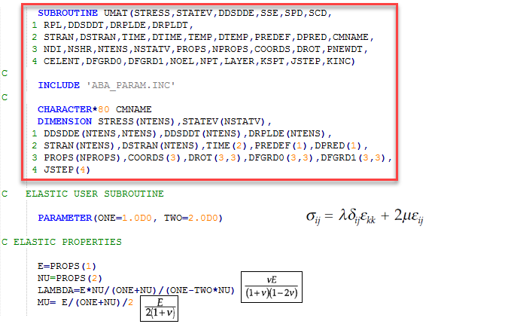
UMAT example for elastic isotropic material
Associate Professorship of Computational Mechanics and Professorship of Wood Technology
Department of Civil, Geo and Environmental Engineering
Technical University of Munich

Slide 18
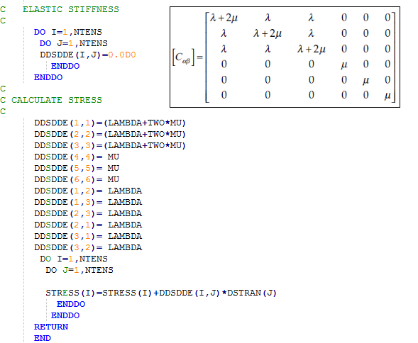
UMAT example for elastic isotropic material
Associate Professorship of Computational Mechanics and Professorship of Wood Technology
Department of Civil, Geo and Environmental Engineering
Technical University of Munich

Slide 19
UMAT Subroutine
Associate Professorship of Computational Mechanics and Professorship of Wood Technology
Department of Civil, Geo and Environmental Engineering
Technical University of Munich
UMAT is the user subroutine for the definition of user based constitutive models in ABAQUS/Standard (VUMAT in ABAQUS/Explicit).
According to the ABAQUS documentation the UMAT subroutine:
Can be used to define the mechanical constitutive behavior of the material.
Can be used with any procedure that includes mechanical behavior.
Can use solution-dependent variables.
Must update at each solution increment, the stresses and the solution dependent variables.
Must provide the material Jacobian matrix (incremental stresses and strains relationship).
As a result, constitutive models of arbitrary complexity can be defined.
This is needed when the material behavior doesn’t follow one of the common models available in the standard library.

Slide 20
Important Points
Associate Professorship of Computational Mechanics and Professorship of Wood Technology
Department of Civil, Geo and Environmental Engineering
Technical University of Munich
Composite materials also come with several challenges compared to normal materials such as metals
Utilizing the user programmable subroutines.
The following distribution of the individual tasks can be given: the fiber provides the strength and stiffness, whereas the matrix gives rigidity and environmental resistance.
The failure is strongly affected by the type of the used material, the fiber distribution and the applied load. Since a composite material can consist of multiple layers, failure may occur within a single ply (intralaminar fracture) or between two plies (interlaminar fracture). The latter is also known as delamination of the bonded plies.
For delamination decohesion interface elements used to represent the decay of strength between sub laminates upon delamination / cohesive elements.

Slide 21
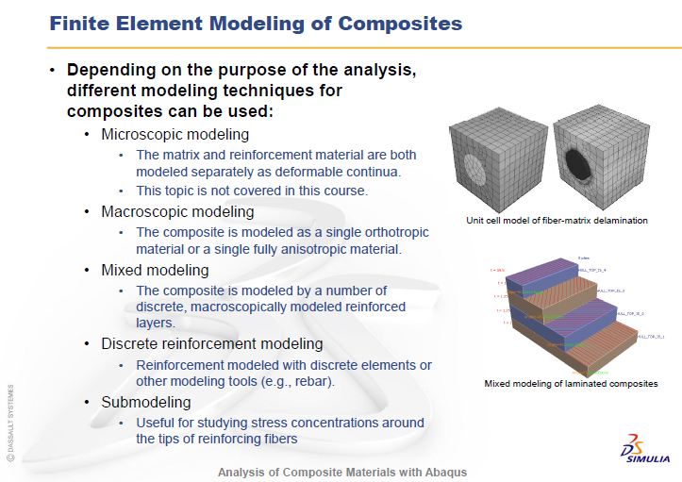
Important Points
Associate Professorship of Computational Mechanics and Professorship of Wood Technology
Department of Civil, Geo and Environmental Engineering
Technical University of Munich

Slide 22
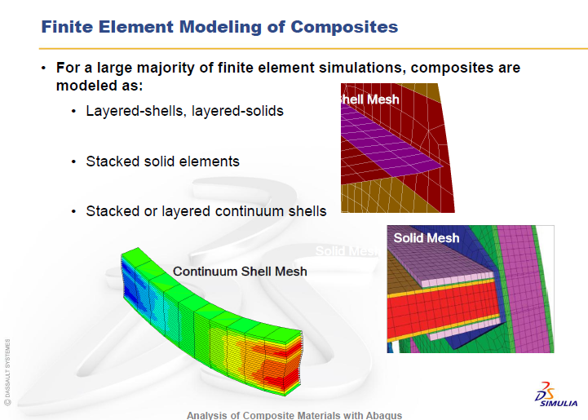
Important Points
Associate Professorship of Computational Mechanics and Professorship of Wood Technology
Department of Civil, Geo and Environmental Engineering
Technical University of Munich

Slide 23
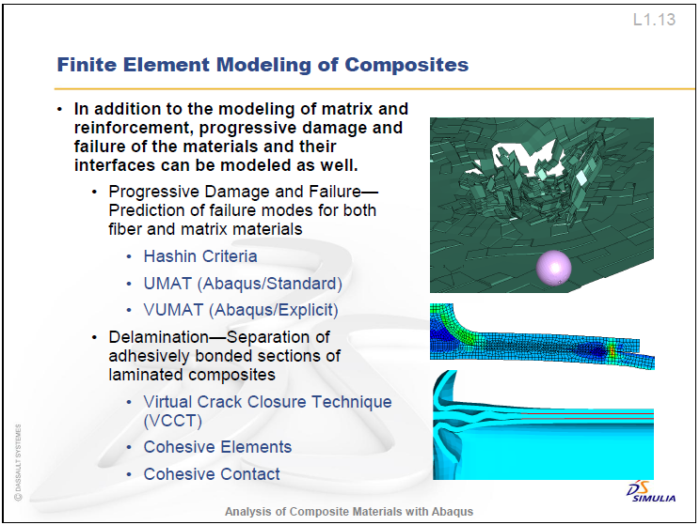
Important Points
Associate Professorship of Computational Mechanics and Professorship of Wood Technology
Department of Civil, Geo and Environmental Engineering
Technical University of Munich

Slide 24
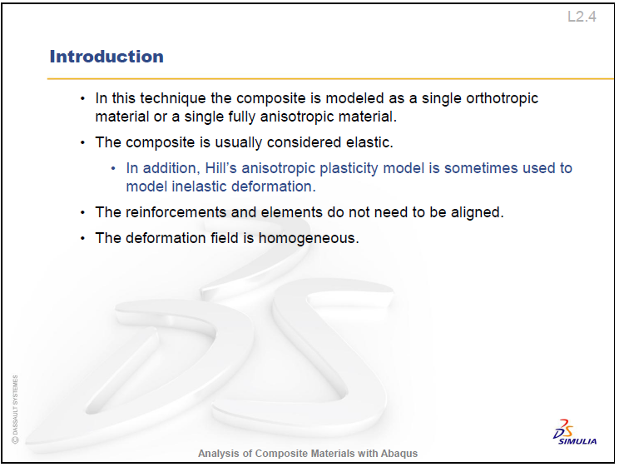
Important Points
Associate Professorship of Computational Mechanics and Professorship of Wood Technology
Department of Civil, Geo and Environmental Engineering
Technical University of Munich

Slide 25
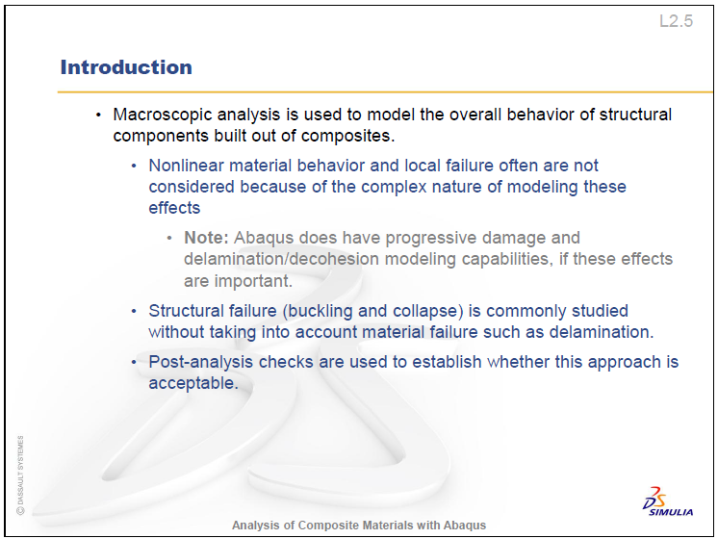
Important Points
Associate Professorship of Computational Mechanics and Professorship of Wood Technology
Department of Civil, Geo and Environmental Engineering
Technical University of Munich

Slide 26
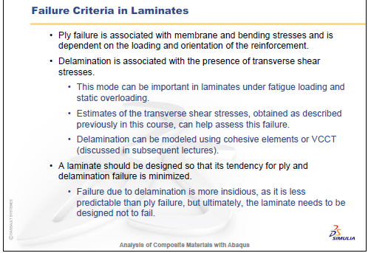
Important Points
Associate Professorship of Computational Mechanics and Professorship of Wood Technology
Department of Civil, Geo and Environmental Engineering
Technical University of Munich

Slide 27
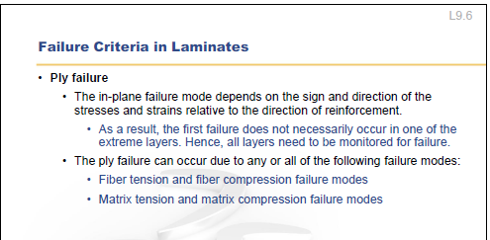
Important Points
Associate Professorship of Computational Mechanics and Professorship of Wood Technology
Department of Civil, Geo and Environmental Engineering
Technical University of Munich

Slide 28
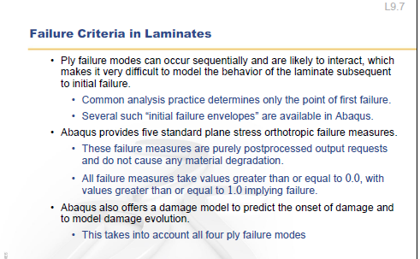
Important Points
Associate Professorship of Computational Mechanics and Professorship of Wood Technology
Department of Civil, Geo and Environmental Engineering
Technical University of Munich

Slide 29
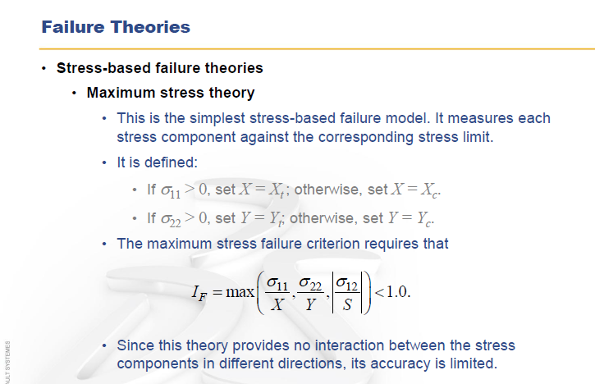
Important Points
Associate Professorship of Computational Mechanics and Professorship of Wood Technology
Department of Civil, Geo and Environmental Engineering
Technical University of Munich

Slide 30
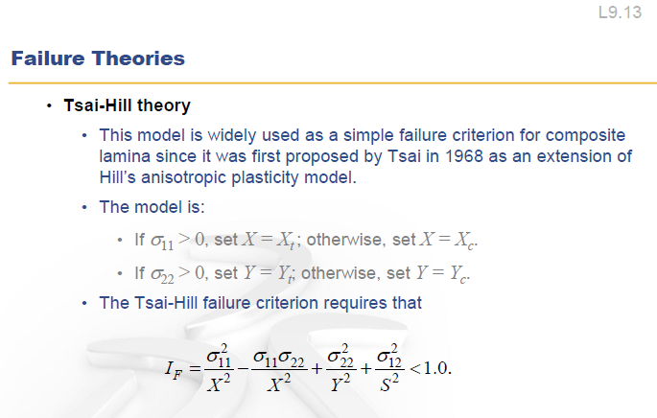
Important Points
Associate Professorship of Computational Mechanics and Professorship of Wood Technology
Department of Civil, Geo and Environmental Engineering
Technical University of Munich

Slide 31
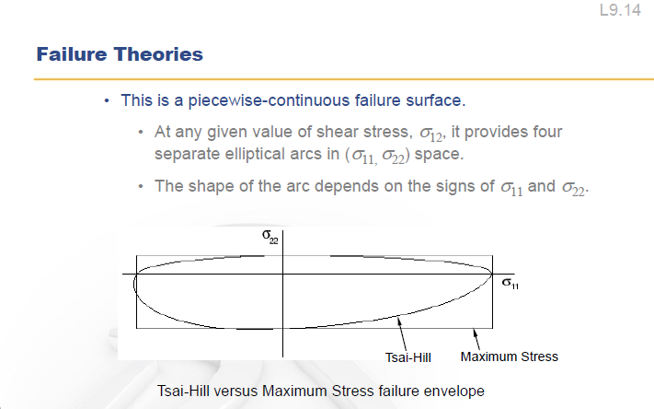
Important Points
Associate Professorship of Computational Mechanics and Professorship of Wood Technology
Department of Civil, Geo and Environmental Engineering
Technical University of Munich

Slide 32
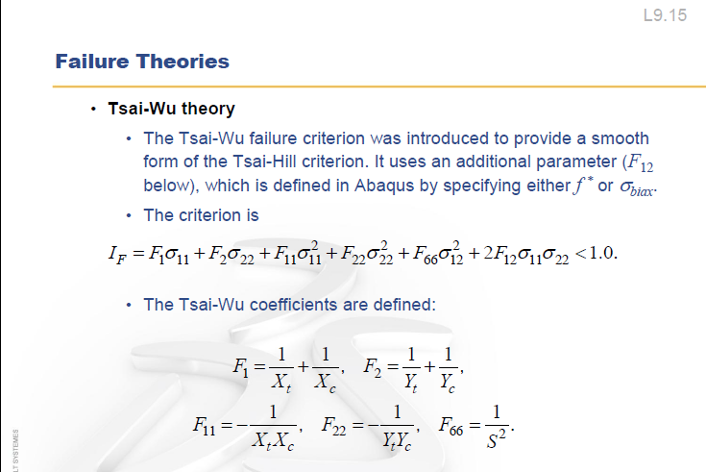
Important Points
Associate Professorship of Computational Mechanics and Professorship of Wood Technology
Department of Civil, Geo and Environmental Engineering
Technical University of Munich

Slide 33
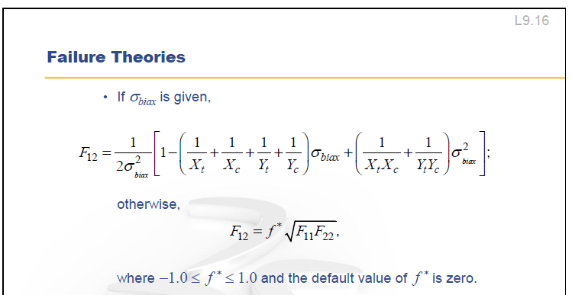
Important Points
Associate Professorship of Computational Mechanics and Professorship of Wood Technology
Department of Civil, Geo and Environmental Engineering
Technical University of Munich

